Slide 1
Launch Computer Simulator
P K Kausik
Sk Imam Akram
P Syamsai
T Satya Himavanth

Slide 2
Table of Contents
Abstract
MIL – STD – 1553 Introduction
Applications of MIL – STD – 1553
MIL – STD – 1553 Commands
First level Diagram
Results
Conclusion
Future work

Slide 3
Abstract
The Launch Simulator project aims to develop a comprehensive simulation platform for emulating the communication between a ground-based system and an On-Board Computer (OBC) during a spacecraft launch.
The simulation utilizes the MIL-STD-1553 protocol, a widely adopted standard for data communication in aerospace applications
The simulator consists of modules representing the Bus Controller (BC) and Remote Terminals (RTs), each emulating the behavior of their real-world counterparts.

Slide 4
Abstract (Cont)
Through the simulation, users can initiate pre-defined launch scenarios, including pre-launch checks, in-flight operations, and post-launch procedures.
The project focuses on accurately replicating the communication flow, error handling mechanisms, and data exchange protocols specified by MIL-STD-1553.

Slide 5
MIL – STD - 1553
MIL - STD - 1553 is a military standard , Digital internal time division command/ response multiplex data bus.
Basic tool used by the D.O.D for integration of weapon systems.
It provides medium for the exchange of data and information between various systems.
It consist of three components
Bus Controller
Remote Terminal
Bus monitor

Slide 6
Pros of MIL STD 1553 protocol
Serial Communication
Dual Redundant Architecture
Fault Tolerance
Standardized Communication
Simple and Reliable

Slide 7
Applications of MIL STD 1553 protocol
Aerospace and Defense Systems
Military Vehicles and Ground Systems
Spacecraft and Satellites
Commercial Aviation
Test and Simulation
Automotive Systems etc..

Slide 8
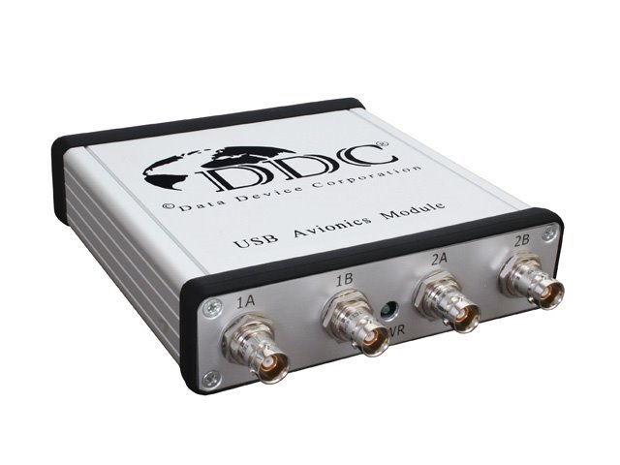
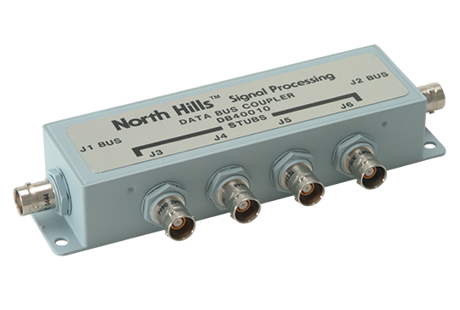
MIL – STD - 1553
USB Avionics Device with MIL-STD-1553 Interface
Box coupler

Slide 9
Bus Controller
This terminal that is assigned the task of initiating information transfer on the data bus
It Decides which RT can Communicate on the Bus.
It can command Remote Terminals to Transmit or Receive Data
Back-up bus controllers are allowed

Slide 10
Remote Terminal
Remote terminal provides interface with a Subsystem
It can also be used to Bridge to Another 1553 Bus
Responds to messages received from the bus controller
31 RT address are allowed per bus

Slide 11
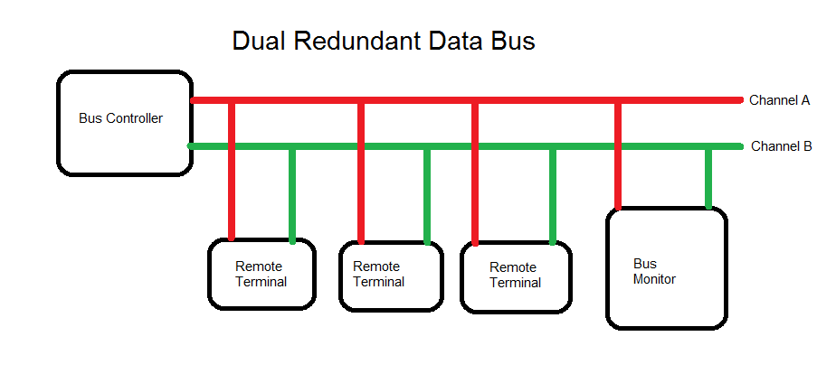
Bus Monitor
Listens to the data bus and extracts data to be used at a later time
Passive – Does not reply to any bus controller command.

Slide 12
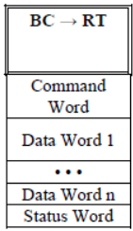
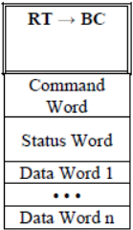
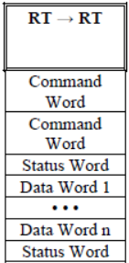
MIL – STD – 1553 : Commands
BC – RT Command
RT - BC Command
RT – RT Command

Slide 13
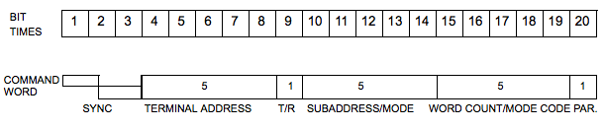
Command Word
Command Word specifies remote terminal function.
Active bus controller transmits CW.
Only BC can issue a command word

Slide 14
Command word bits elaboration
Sync: Bits 0-3
Command Word structure: Command sync + 16-bit info field.
TA field: Bits 4-8
Ensures unique terminal addressing.
Transmit/Receive (T/R): 9th Bit
data flow direction from remote terminal's perspective.
Sub-address/Mode Command: 10-14 Bits
00000B or 11111B indicate Mode Code Command.
Word Count (WC) Field: Bits 15-19
Defines mode code or data word count.
00000B equals 32 data words.
Word Parity Bit: Bit 20
Ensures odd parity.
Data integrity check.

Slide 15
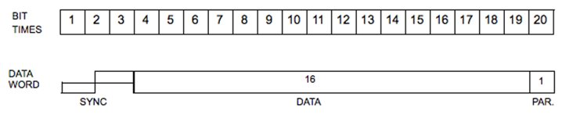
Data Word
Data words can be transmitted by either a remote terminal (transit command) or a bus controller (receive command).
The next sixteen bits of information are left to the designer to define. The only standard requirement is that the most significant bit (MSB) of the data be transmitted first.
The last bit (bit time 20) is the word parity bit. Only odd parity is used.

Slide 16
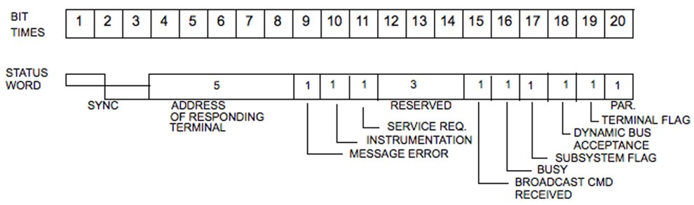
Status Word
A remote terminal in response to a valid message transmits only the status word (SW).
The status word is used to convey to the bus controller whether a message was properly received or to convey the state of the remote terminal (i.e., service request, busy, etc.).

Slide 17
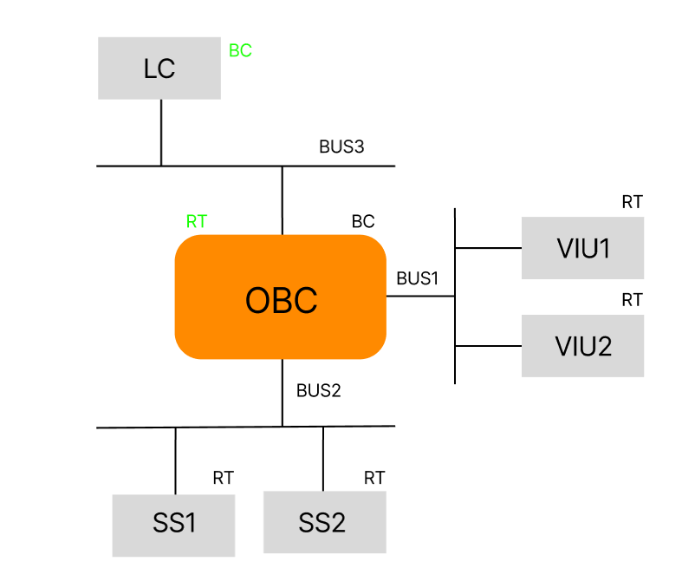
First Level Diagram

Slide 18
1. Launch Computer (LC):
The Launch Computer is a vital component of launch vehicles and spacecraft.
It serves as the central processing unit responsible for executing pre-launch sequences, monitoring vehicle health, and controlling critical functions during the launch phase.
LC manages tasks such as propulsion system ignition, stage separation, and payload deployment.
It interfaces with various subsystems and sensors to gather data and execute commands, ensuring the successful execution of the mission.

Slide 19
2. On-Board Computer (OBC):
The On-Board Computer is a computer system embedded within a spacecraft or satellite.
It serves as the brain of the spacecraft, controlling its operations, managing payloads, and executing mission-specific tasks autonomously or in response to ground commands.
OBC handles navigation, guidance, and control functions, maintaining the spacecraft's orientation, trajectory, and stability.
It communicates with ground control stations and other spacecraft systems, exchanging data, telemetry, and commands to facilitate mission objectives and ensure mission success.

Slide 20
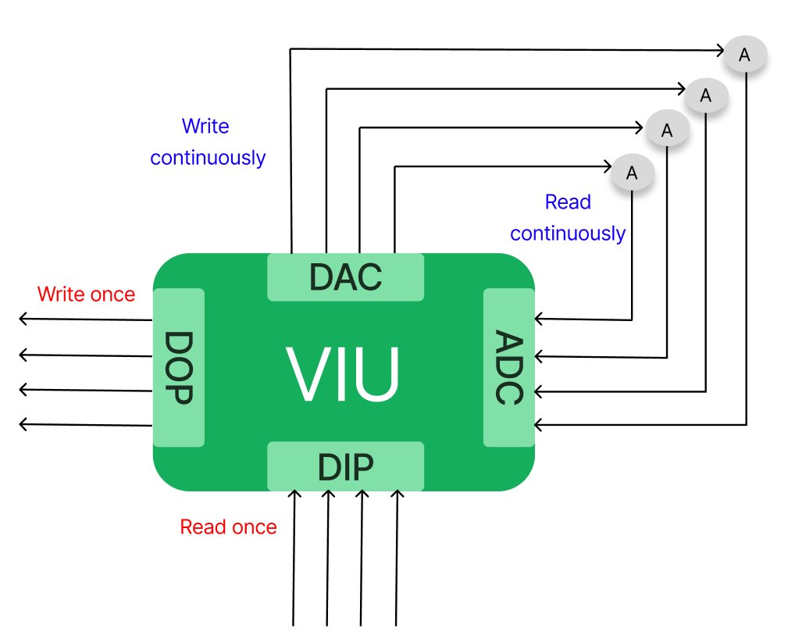
VIU architecture

Slide 21
Components of Vehicle Interface Unit Architecture
Processor: It is used process the data collected by sensors.
1553 Module: It is used to send and receive messages between sensors, actuators and processor.
DIP (Discreet Input): It is used to send input when required by the user when certain conditions are met.
DOP (Discreet Output): It is used to receive data(output) for the input command.
DAC (Digital to Analog Converter): It is used to convert digital inputs into electrical voltages for actuators.
ADC (Analog to Digital Convertor): It is used to voltages back to digital values for checking errors.

Slide 22
Health Check command
LC to OBC wordcount : 6
Word no | Nomenclature
1 | Header
2 | Sequence no
3 | Sub System ID
4 | Command ID
5 | Functional ID
6 | Checksum

Slide 23
Health Check Response
OBC to LC wordcount : 9
Word no | Nomenclature
1 | Header
2 | Sub system ID
3 | Command ID
4 | Function command ID
5 | BSW
6 | Status
7 | Spare
8 | Sequence no
9 | Checksum

Slide 24
Version Check command
LC to OBC wordcount : 6
Word no | Nomenclature
1 | Header
2 | Sequence no
3 | Sub System ID
4 | Command ID
5 | Functional ID
6 | Checksum

Slide 25
Version Check Response
OBC to LC wordcount : 9
Word no | Nomenclature
1 | Header
2 | Sub system ID
3 | Command ID
4 | Function command ID
5 | BSW
6 | Spare
7 | Spare
8 | Sequence no
9 | Checksum

Slide 26
Data Load command
LC to OBC wordcount : 6
Word no | Nomenclature
1 | Header
2 | Sequence no
3 | Sub System ID
4 | Word count
5 | Command ID
6 | Functional ID
7 | Checksum

Slide 27
Data Load data details
LC to OBC wordcount : 32
Word no | nomenclature
0-3 | Target Latitude
4-7 | Target Longitude
8-11 | Target Latitude
12-15 | Reserved
16-19 | Reserved
20-23 | Reserved
24-31 | Reserved

Slide 28
Message Block creation Types
Type 1: BC to RT
It is used to send message/ data from BC to RT.
Type 2: RT to BC
It is used to receive response/ data from RT to BC.
Type 3: BC to RT & RT to BC
It is of two parts (Part 1, Part 2)
Part 1 is used to send message/ data from BC to RT, Part 2 is used to receive response/ data from RT to BC. Major and Minor Frames of Part 2 should be same as Part 1 to link both messages.

Slide 29
Message Block Creation Type 1
aceBCDataBlkCreate(DevNum,DBLK1,32,syncMsgBuff,32);
aceBCMsgCreateBCtoRT(
DevNum, /* Device number */
MSG1, /* Message ID to create */
DBLK1, /* Message will use this data block */
1, /* RT address */
1, /* RT subaddress */
2, /* Word count */
0, /* Default message timer */
bus_channel); /* use chl A options */
/* Create XEQ opcode that will use msg block */
aceBCOpCodeCreate(DevNum,OP1,ACE_OPCODE_XEQ,ACE_CNDTST_ALWAYS,MSG1,0,0);
/* Create CAL opcode that will call mnr frame from major */
aceBCOpCodeCreate(DevNum,OP2,ACE_OPCODE_CAL,ACE_CNDTST_ALWAYS,MNR1,0,0);
aOpCodes[0] = OP1;
aceBCFrameCreate(DevNum,MNR1,ACE_FRAME_MINOR,aOpCodes,1,0,0); /* Create Minor Frame */
aOpCodes[0] = OP2;
aceBCFrameCreate(DevNum,MJR1,ACE_FRAME_MAJOR,aOpCodes,1,1000,0); /* Create Major Frame */
aceBCInstallHBuf(DevNum,32*1024); /* Create Host Buffer */

Slide 30
Message Block Creation Type 2
aceBCDataBlkCreate(DevNum,DBLK10,32,msgResBuff,32);
aceBCMsgCreateRTtoBC(
DevNum, /* Device number */
MSG10, /* Message ID to create */
DBLK10, /* Message will use this data block */
1, /* RT address */
2, /* RT subaddress */
32, /* Word count */
0, /* Default message timer */
bus_channel); /* use chl A options */
/* Create XEQ opcode that will use msg block */
aceBCOpCodeCreate(DevNum,OP19,ACE_OPCODE_XEQ,ACE_CNDTST_ALWAYS,MSG10,0,0);
/* Create CAL opcode that will call mnr frame from major */
aceBCOpCodeCreate(DevNum,OP20,ACE_OPCODE_CAL,ACE_CNDTST_ALWAYS,MNR10,0,0);
aOpCodes[0] = OP19; /* Create Minor Frame */
aceBCFrameCreate(DevNum,MNR10,ACE_FRAME_MINOR,aOpCodes,1,0,0);
aOpCodes[0] = OP20; /* Create Major Frame */
aceBCFrameCreate(DevNum,MJR10,ACE_FRAME_MAJOR,aOpCodes,1,1000,0);
aceBCInstallHBuf(DevNum,32*1024); /* Create Host Buffer */

Slide 31
Message Transmission Type 1
Type 1: Sending a message:
Data Block that is to be transferred [DBLK1 of message block type BC to RT] should be written in aceBCDataBlkWrite(). Time delay is not needed for sending a message. Major Frame ID[MJR1] should be same as in message block.
aceBCDataBlkWrite(DevNum, DBLK1, syncMsgBuff, 32,0);
/* Start BC */
aceBCStart(DevNum, MJR1, 1);
/* Stop BC */
aceBCStop(DevNum);

Slide 32
Message Transmission Type 2
Type 2: Receiving a message:
Major Frame ID [MJR10] of the Data Block that is to be received [DBLK10] should be written in aceBCStart(). Time delay is needed to get the data from OBC [Minimum 10-15 ms]. aceBCDataBlkRead() is used to paste the received information into the receive buffer [msgResBuff].
Note: Receive buffer should always be empty(0x00) else the code will crash.
aceBCStart(DevNum, MJR10, 1);
/* Stop BC */
// timeDelay(10);
for(int i=0; i<1500000; i++);
aceBCStop(DevNum);
aceBCDataBlkRead(DevNum,DBLK10,msgResBuff,32,0);

Slide 33
Functions used for type conversions:
Float array to Hex array
void WriteFloat_hex(U16 noe, FLOAT_32* arrayData, U16* Temp_Buff){
union{
WORD wordData[2];
FLOAT_32 fData;
}un;
int i;
int j;
for (i = 0; i < noe; i++){
un.fData = arrayData[i];
for (j = 0; j < 2; j++){
Temp_Buff[((2 * i) + j)] = un.wordData[(j)];
}
}
}

Slide 34
Hex array to Float array
void ReadFloat_hex(WORD noe, WORD* data, FLOAT_32* op){
SINT_32 i;
SINT_32 j;
union{
WORD wordData[2];
FLOAT_32 fData;
}un;
for (i = 0; i < noe; i++){
for (j = 0; j < 2; j++)
{
un.wordData[(j)] = data[((2 * i) + j)];
}
op[i] = un.fData;
}
}

Slide 35
Double array to Hex array
void WriteDouble_hex(U16 noe, FLOAT_64* arrayData, U16* Temp_Buff){
union{
WORD wordData[4];
FLOAT_64 dData;
}un;
int i;
int j;
for (i = 0; i < noe; i++){
un.dData = arrayData[i];
for (j = 0; j < 4; j++){
Temp_Buff[((4 * i) + j)] = un.wordData[(j)];
}
}
}

Slide 36
Hex array to Double array
void ReadDouble_hex(WORD noe, WORD* data, FLOAT_64* op){
SINT_32 i;
SINT_32 j;
union{
WORD wordData[4];
FLOAT_64 dData;
}un;
for (i = 0; i < noe; i++){
for (j = 0; j < 4; j++){
un.wordData[(j)] = data[((4 * i) + j)];
}
op[i] = un.dData;
}
}

Slide 37
Time Delay code
void MainWindow::timeDelay(int x){
QTimer *timer;
timer = new QTimer(this);
timer->setTimerType(Qt::PreciseTimer);
timer->start(0);
timer->setInterval(x);
// ui->progressBar_1->setValue(0);
while(timer->remainingTime()){
// ui->progressBar_1->setValue((x - timer->remainingTime() )/100 * 2);
}
// ui->progressBar_1->setValue(100);
}

Slide 38
Results

Slide 39
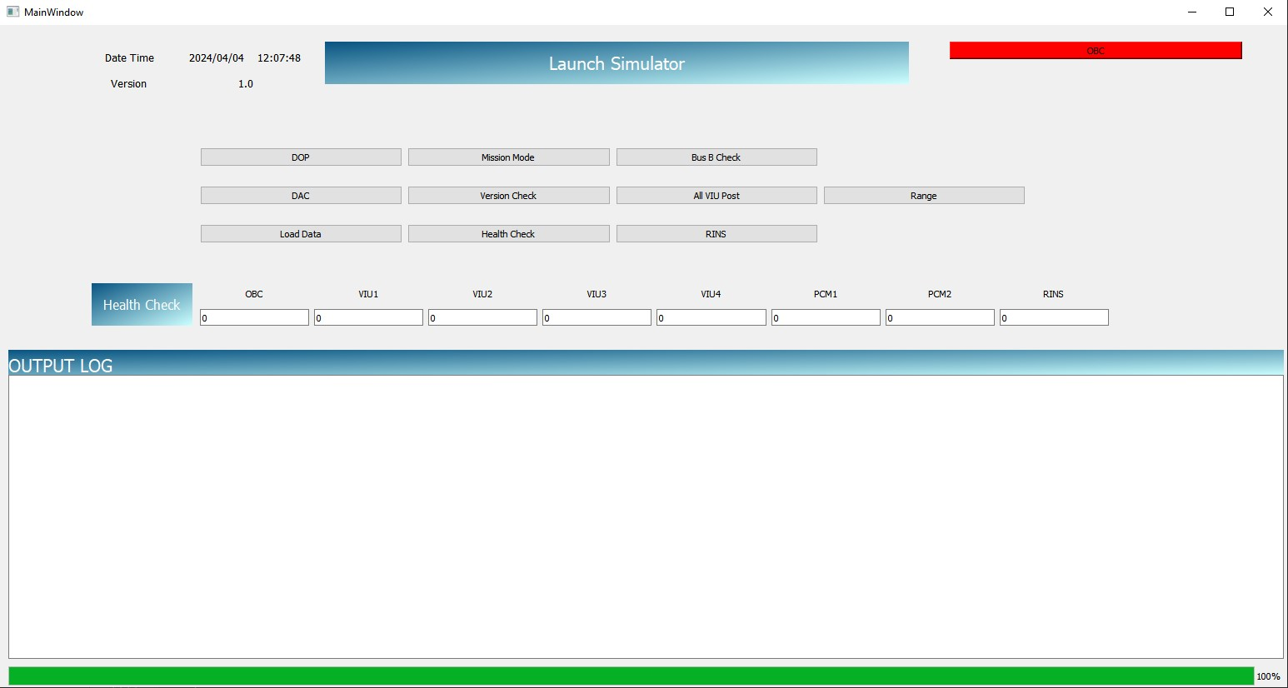
Main page OBC button turns red if OBC is not connected.

Slide 40
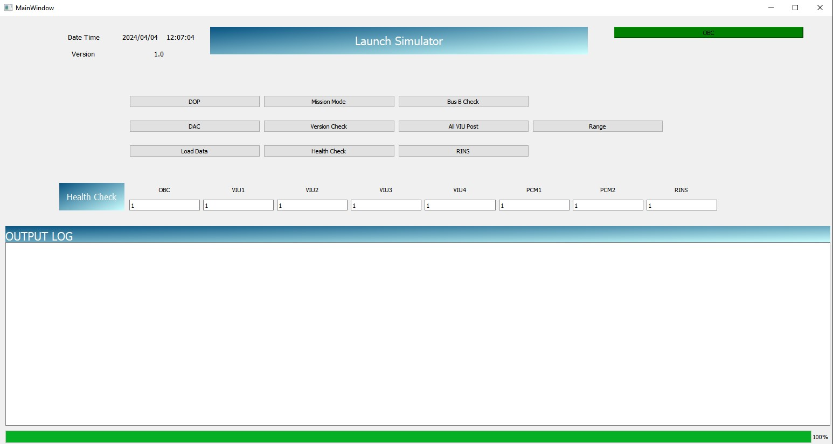
Main page OBC button turns green if OBC is connected.

Slide 41
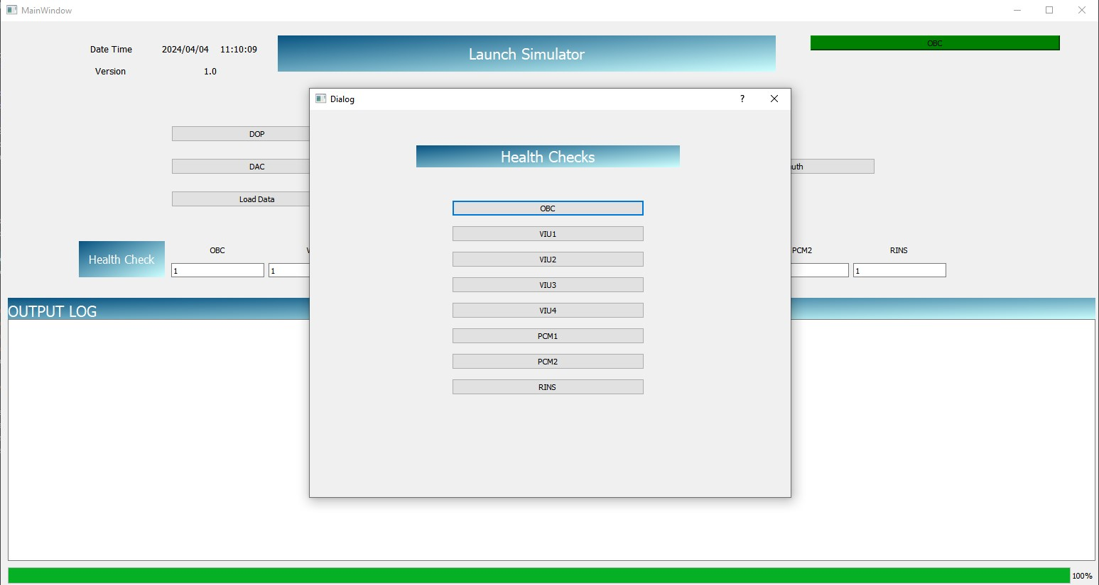
Health check

Slide 42
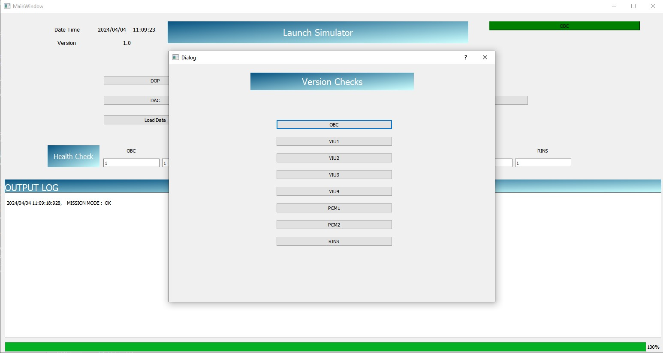
Version Check

Slide 43
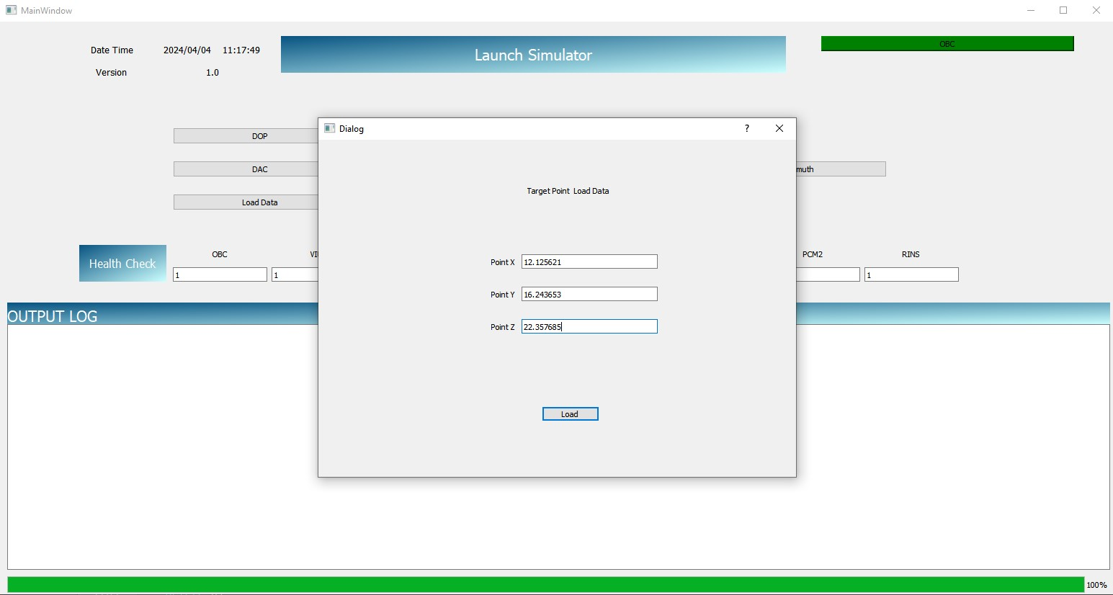
Load Data

Slide 44
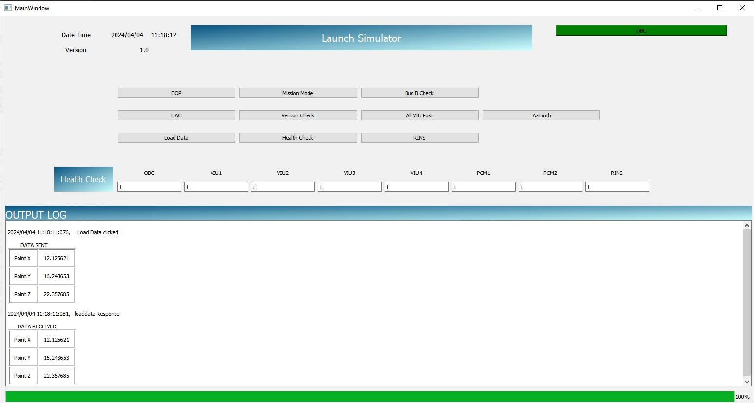
Load Data execution

Slide 45
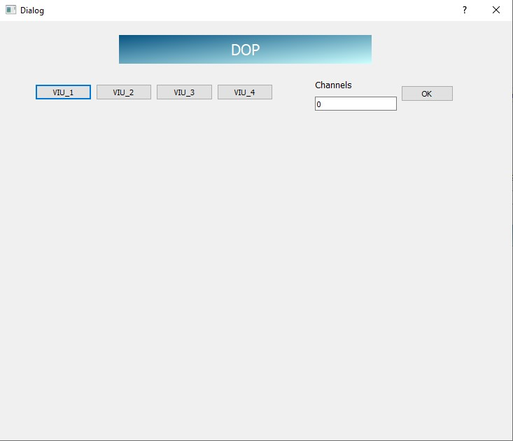
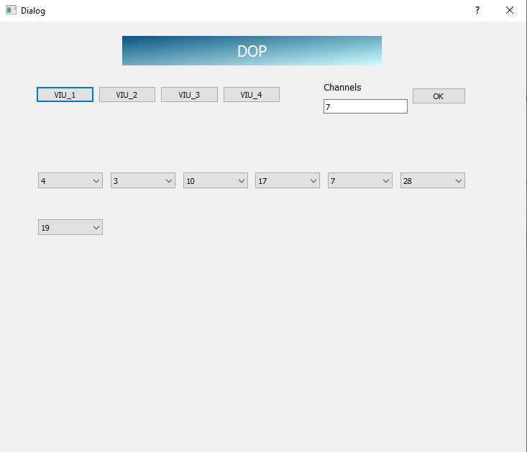
DOP

Slide 46
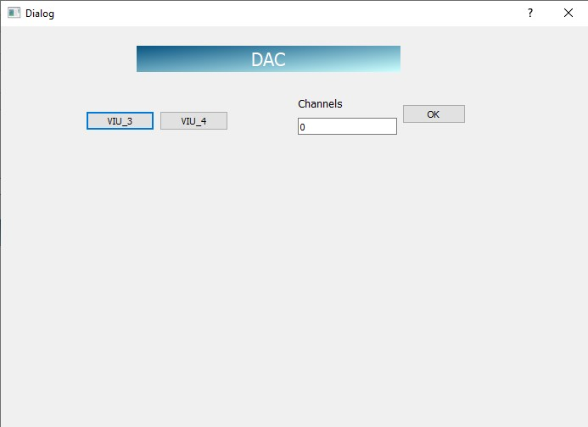
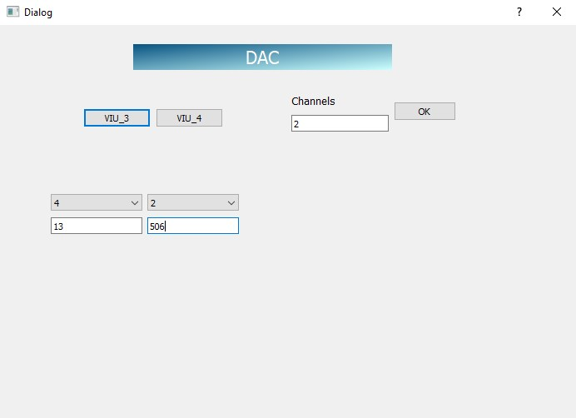
DAC

Slide 47
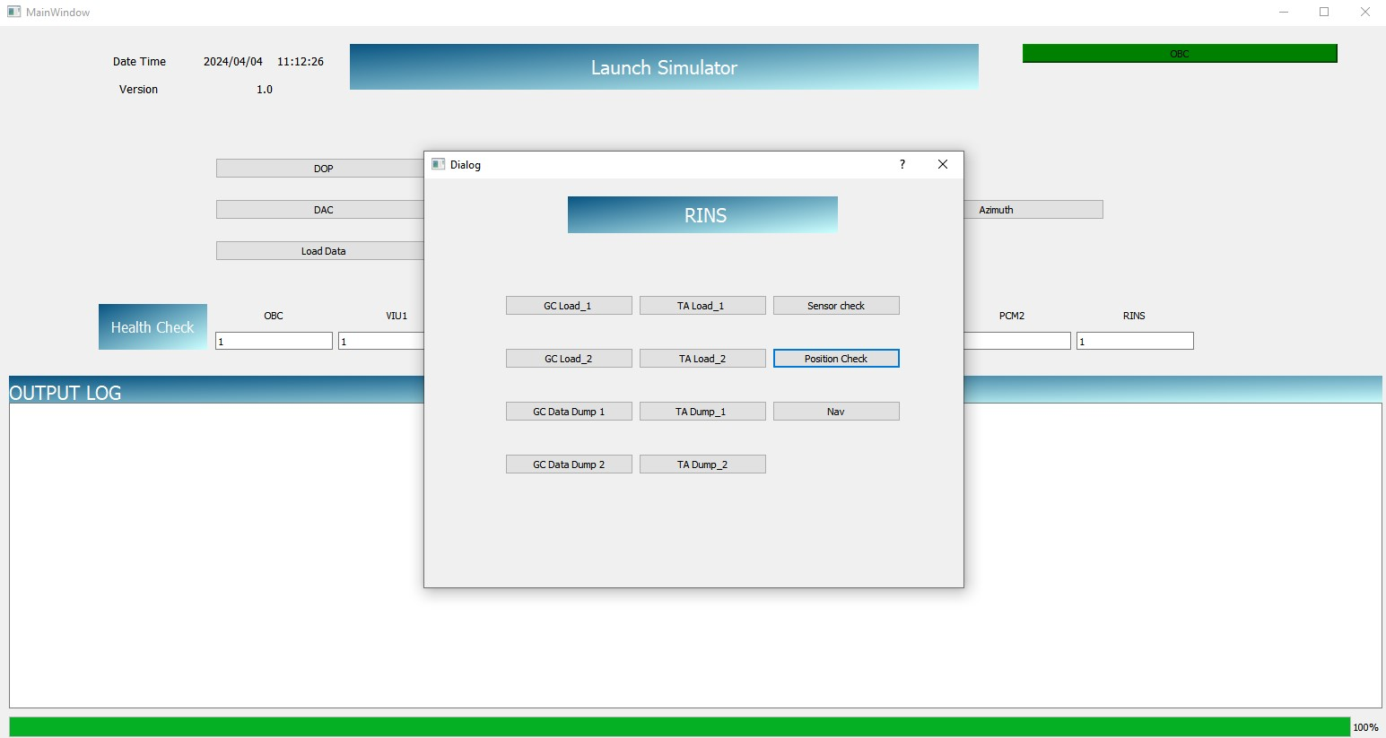
RINS

Slide 48
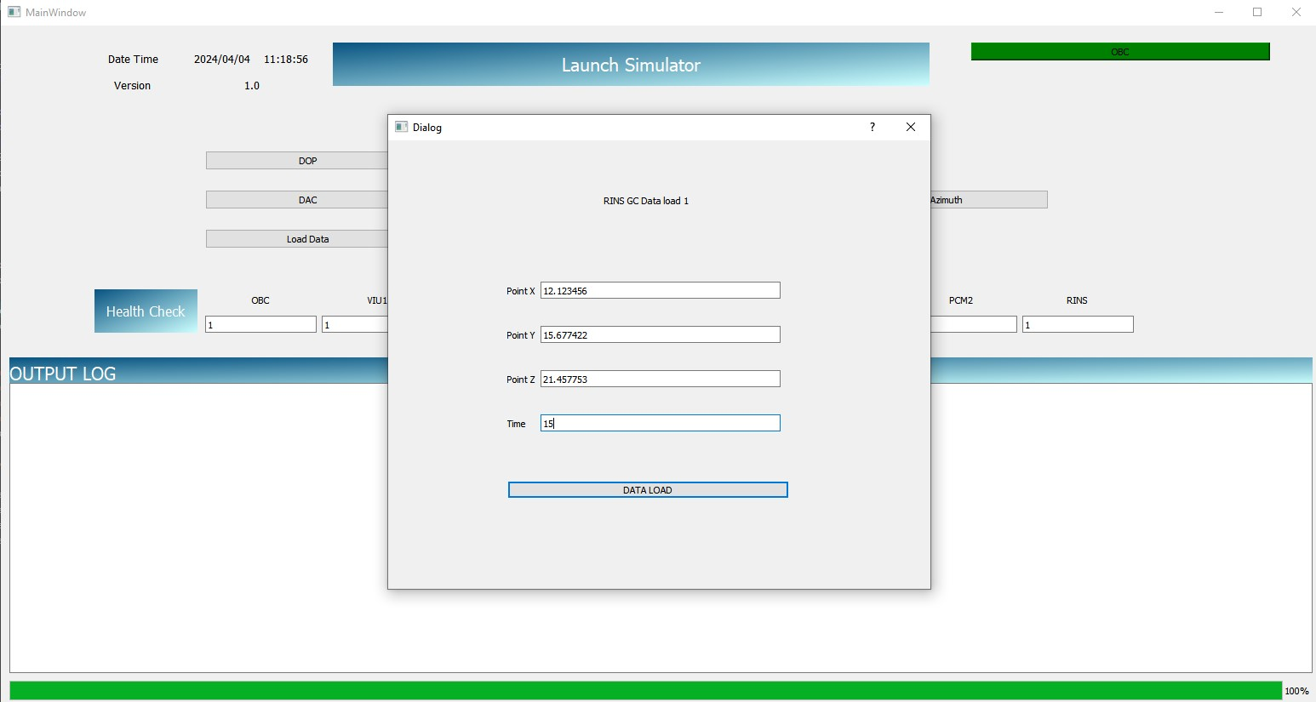
RINS GC DATA LOAD 1

Slide 49
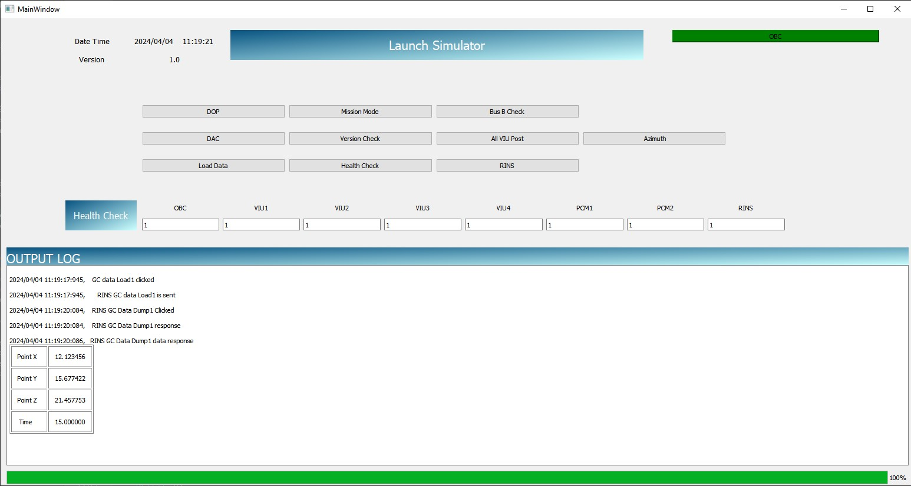
RINS GC DATA DUMP 1`

Slide 50
Conclusion
By establishing a robust communication link between the launch computer and the OBC, this system enhances the efficiency, reliability, and safety of spacecraft operations.
Key features of the communicator include fault tolerance, real-time performance, and interoperability with diverse spacecraft systems and subsystems.
Furthermore, the communicator enhances the autonomy of spacecraft operations by enabling onboard processing, command execution, and adaptive responses to dynamic mission conditions.
In summary, the launch computer to OBC communicator represents a vital component of modern space missions, enabling efficient and reliable communication between ground-based systems and spacecraft.

Slide 51
Future Work
Integration with Real Hardware: Extend the simulation environment to integrate with real hardware components for more comprehensive testing and validation
Enhanced User Interfaces: Further refine the user interface design to enhance usability, accessibility, and visualization of simulation data
Industry Collaboration: Collaborate with industry partners and stakeholders to validate the simulation environment in real-world scenarios and gather feedback for continuous improvement.

Slide 52
Thank You

